Slide 1
Experiments and results

Slide 2
Lang Id
Others
Exp 1: Full data
Exp 2: Pure data
All sentences
Split sentences no longer than 15 words
Exp 3 : Other corpus
Exp 4: comparing with others
Exp 5: 3 languages
Exp 6: Scikit learn : NB, SVM
Exp 7 : Word gram and char gram

Slide 3
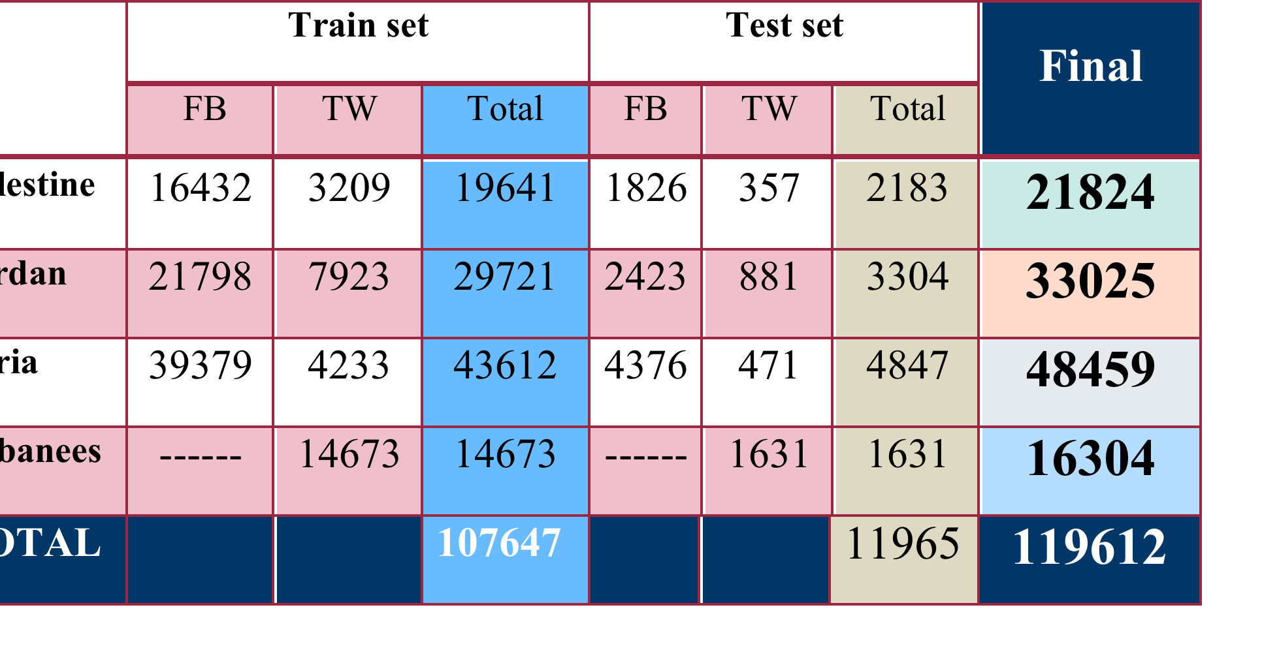
Exp 1.1: using Full data

Slide 4
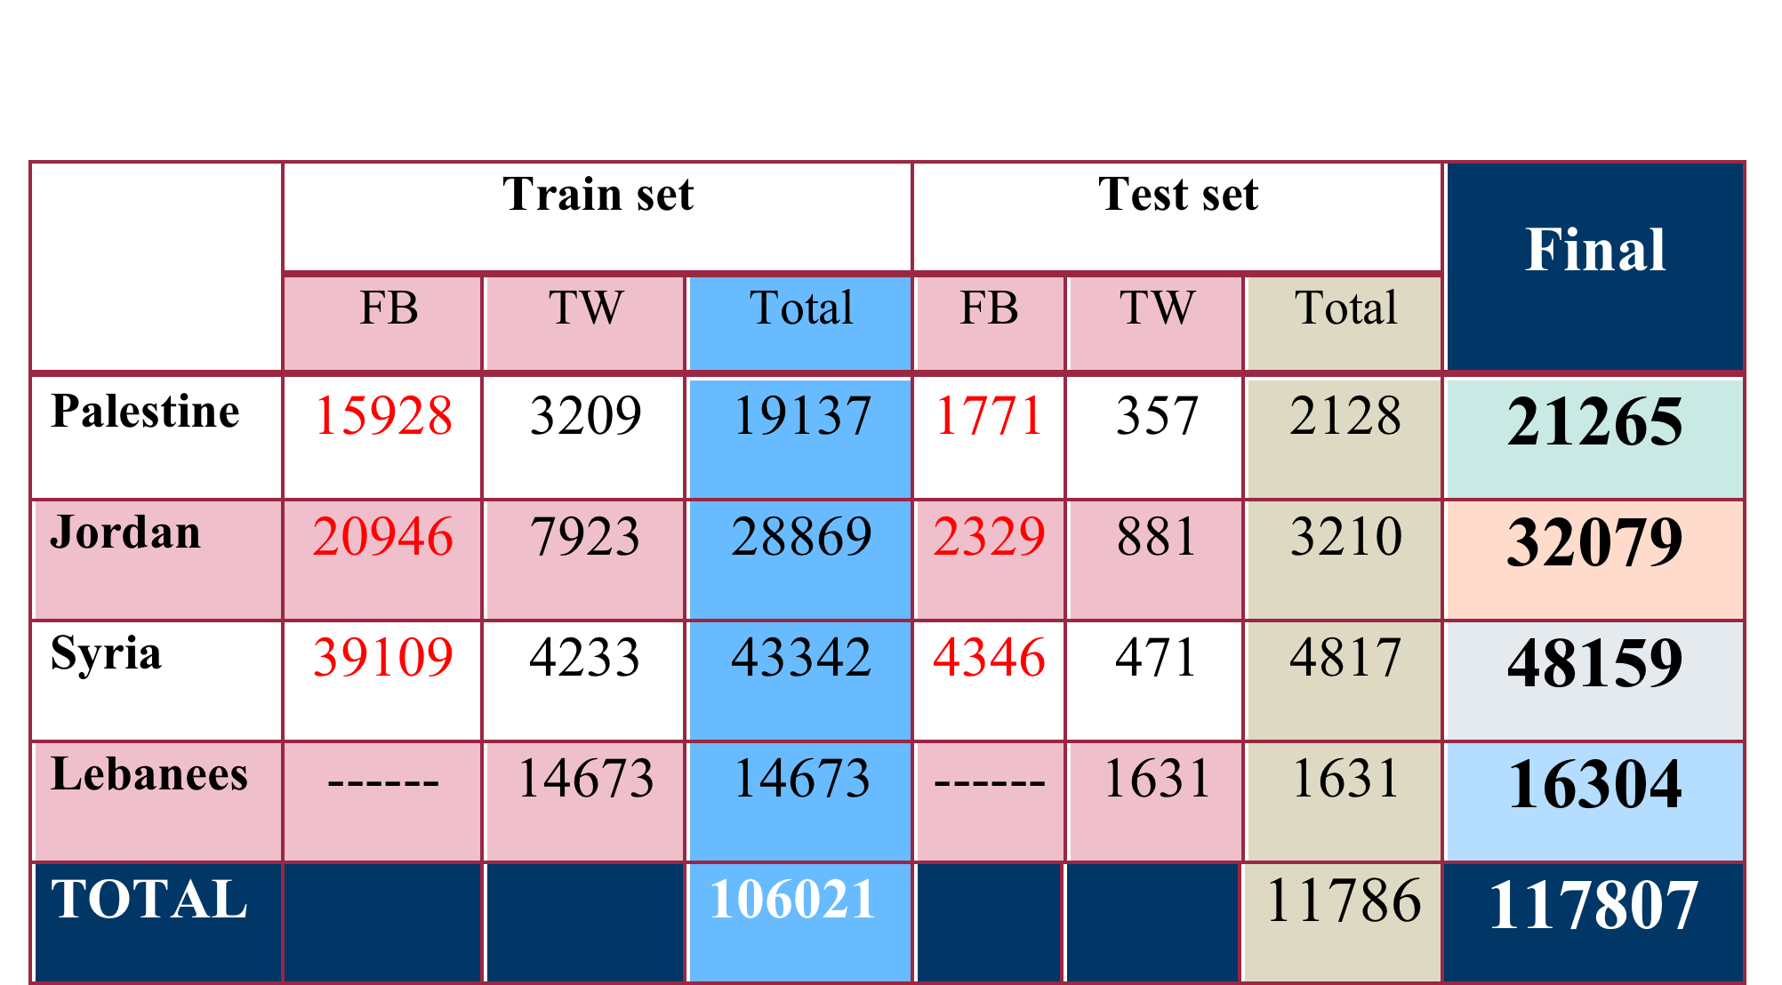
Exp 1.2 : Cleaning Full data

Slide 5
Exp 1.1: using Full data
Exp 1.2: clean Full data
 | FB |  | TW
 | Acc | F | Acc | F
4 | 41 | 56 | 32 | 48
5 | 38 | 58 | 35 | 49
6 | 41 | 58 | 35 | 48
7 | 41 | 57 | 34 | 47
 | FB |  | TW
 | Acc | F | Acc | F
4 | 41 | 58 | 31 | 47
5 | 41 | 57 | 35 | 48
6 | 35 | 58 | 35 | 52
7 | 42 | 58 | 35 | 51

Slide 6
Exp 2.1 : Pure Corpus
Exp 2.2 : Split Pure Corpus
 | Train | Test | Total
Jordan | 6316 | 702 | 7018
Palestine | 9577 | 1065 | 10642
Syria | 33983 | 3776 | 37759
Lebanon | 9747 | 1083 | 10830
 | Train | Test | Total
Jordan | 15653 | 1740 | 17393
Palestine | 19368 | 2153 | 21521
Syria | 53766 | 5974 | 59740
Lebanon | 17329 | 1926 | 19255

Slide 7
Exp 2.1: Pure data
Exp 2.2: short data
 | Acc | F
4 | 54 | 70
5 | 56 | 71
 | Acc | F
4 | 49 | 66
5 | 51 | 68

Slide 8
Exp 3: other Corpus (Padic + Nizar)

Slide 9
Exp 3,4: other Corpus (Padic + Nizar)
Padic (Pa , SY) / Our Corpus
Nizar (Jo, Pa, Sy) / Our Corpus
 | Acc | F
4 | 61 | 75
5 | 64 | 78
 | Acc | F
4 | 63 | 77
5 | 68 | 81
 | Acc | F
4 | 73 | 83
5 | 72 | 83
 | Acc | F
4 | 64 | 78
5 | 65 | 79

Slide 10
Exp 5: 3 Languages
Pal – Syr – Leb
 | Acc | F
4 | 58 | 73
5 | 59 | 73
Pal – Jor – Leb
 | Acc | F
4 | 61 | 75
5 | 61 | 76
Jor – Syr – Leb
 | Acc | F
4 | 64 | 78
5 | 66 | 80

Slide 11
Exp 6: sklearn
 | Acc | F
Word gram | 67 | 60
Uni_word Sample | 70 | 71
Bi_word Sample | 70 | 70
Tri_word Sample | 70 | 70
N-char wb 5 g | 69 | 64
N-char wb 5 g (data sampling) | 69 | 70
SVM | 59 | 47
SVM (Sampling) | 67 | 67
Data Sampling : Syrian train file >>> 10.000 (36096), before (59623)

Slide 12
Exp 6: other Corpus (Padic + Nizar)
Padic (Pa , SY) / Our Corpus
Nizar (Jo, Pa, Sy) / Our Corpus
 | Acc | F
Uni-w | 83 | 83
Bi-w | 84 | 83
5g | 82 | 83
 | Acc | F
Uni-w | 69 | 68
Bi-w | 69 | 69
5g | 73 | 73
 | Acc | F
Uni-w | 87 | 85
Bi-w | 81 | 74
5g | 78 | 80
 | Acc | F
Uni-w | 77 | 71
Bi-w | 70 | 60
5g | 74 | 74

Slide 13
Exp 6: scikit learn NB 3 Languages
Pal – Syr – Leb
 | Acc | F
5 | 77 | 74
Pal – Jor – Leb
 | Acc | F
5 | 74 | 74
Jor – Syr – Leb
 | Acc | F
Uni word | 75 | 69
Bi.word | 70 | 60
5 | 81 | 82

